Slide 1
Developing Custom Applications using Power BI Embedded

Slide 2
Agenda
Power BI Embedded Overview
Working with PBIX Project Files
Provisioning Workspaces in Azure
Embedding Reports in a MVC Application
Configuring Datasets for DirectQuery Mode
Putting It All Together

Slide 3
What is Power BI?
What is Power BI?
Cloud-based subscription service
Environment which promotes self-service BI to the end user
BI Platform to assists with data import, analysis and visualization
Power BI benefits from being a cloud-based service
It takes only 5 seconds to subscribe to the Power BI service
New users can create something significant in 5 minutes or less
Power BI adoption numbers (as of Q1 2016)
5 million subscribers
200,000 organizations
40 different languages
Notes:
Power BI is a cloud-based subscription service from which provides business users with an environment participate in self-service BI. For ad-hoc scenarios is provides an end user with a straight-forward manner to import and analyze and to visualize insights from that data. To system integrators and data professionals, Power BI represents a platform for creating business solutions that assists with data analysis and insight visualization.
Because Power BI benefits is a cloud-based service, a new user can subscribe in under a minute. Another important goal of the Power BI team at Microsoft was to remove dependencies so that new users can quickly begin importing data and creating visuals using nothing more than the browser.
As of March 2016, the Power BI service has experience strong adoption numbers. The Power BI service has surpassed 5 million subscribers who come from over 200,000 different organizations. The Power BI service subscribers come from many different countries and take advantage of the fact that the Power BI service has been localized for over 40 different languages.

Slide 4
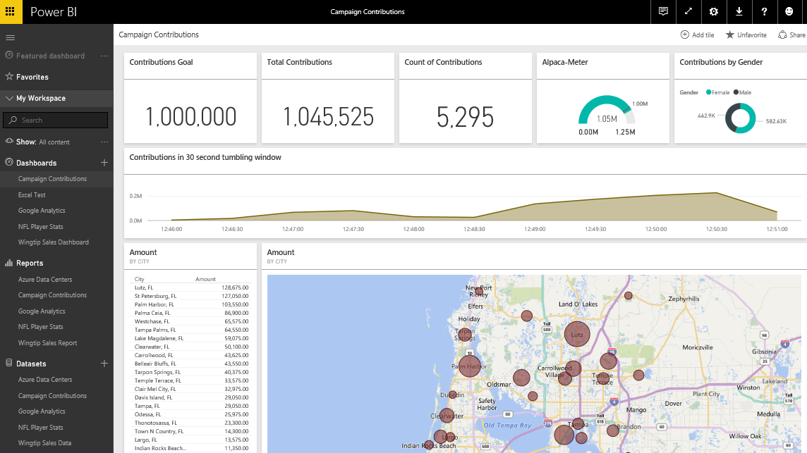
The Power BI Service
The Power BI Service
Provides cloud-based foundation for Power BI platform
Accessible through browser at https://app.powerbi.com
Notes:
You can think of the Power BI service as the heart and sole of the Power BI platform. Subscribed users access the Power BI service using any modern browser through its primary URL which is https://app.powerbi.com. Once a user has been authenticated against the common endpoint of https://app.powerbi.com, the users is then connected to the Azure data center which hosts the user’s Power BI workspaces.
Using the browser, a Power BI subscriber can view dashboard and interactive reports. The browser-based experience of the Power BI service also provides support to import datasets and to create reports and dashboards.

Slide 5
Power BI Service Architecture
Power BI support for authors and consumers
BI solution authors have a choice in authoring tools
BI solutions consumers can use wide range of devices
Power BI Solution Authors
Power BI Service
Power BI Solution Consumers
Browser
Browser
Power BI Solution 1
iPad App
Power BI Desktop
Power BI Solution 2
iPhone App
Microsoft Excel 2016
Power BI Solution 3
Android App
Windows 10 Phone App
Custom Application
Power BI Solution 4
Custom Application
Notes:
Power BI is a platform that can be used to perform ad-hoc data analytics and reporting. It is also a platform that caters to BI solution authors and the consumers of those BI solutions.
BI solution authors can choose between authoring tools including the browser, Power BI Desktop and Microsoft Excel. Microsoft positions Power BI Desktop as the premiere tool for authoring BI solutions due to its powerful features of Power Query and Power Pivot. Note that it is also possible for application developers to automate the creation of a BI solution in the Power BI service using the Power BI REST API.
Another powerful aspect of the BI platform is that BI solutions consumers can use wide range of devices to access dashboard and reports in the Power BI service. Dashboards and reports are fully accessible across recent versions of the industry's most popular browsers including Internet Explorer, Edge, Chrome, FireFox, Opera and Safari. The Power BI platform also provides a Power BI consumer app on devices including iPhones, iPad, Android, Windows surface and Windows 10 phone. It is also possible for application developers to embed Reports and Dashboard tiles from Power BI into external applications and websites.

Slide 6
What is Power BI Embedded
An Azure Service – Provisioned on demand
Decouples user security from app security
Opens Power BI up to commercial applications

Slide 7
PowerBI.com vs Power BI Embedded
PowerBI.com
-----------------------
Accessed via https://app.powerbi.com
Requires Office 365 accounts
Requires Power BI License
Custom development not required
Azure subscription not required
Power BI Embedded
-----------------------
Accessed via custom URL
No Office 365 accounts required
No Power BI user licenses required
Requires custom development
Requires Azure subscription

Slide 8
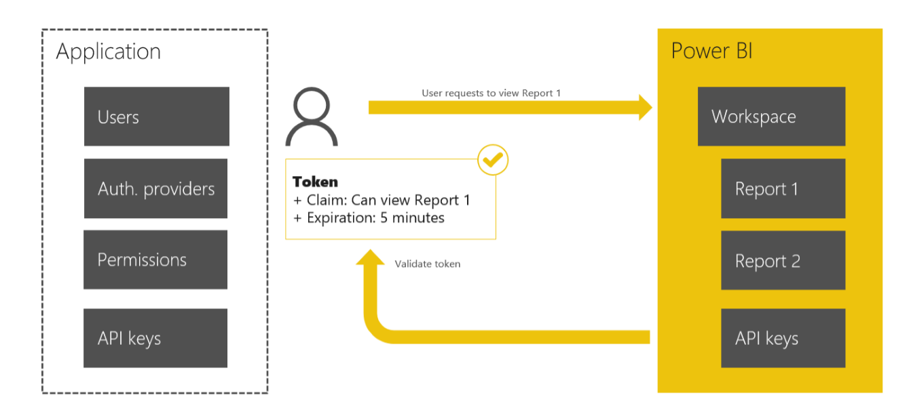
Security with Power BI Embedded
Microsoft Power BI Embedded defers to your application to perform all the necessary user authentication and authorization

Slide 9
Access Token Types
Azure Provisioning Tokens
Used when provisioning a new Workspace into Workspace Collection
Development Tokens
Used when making calls directly to the Power BI REST APIs Power BI
Embedding Tokens
Used when making calls to render a report in the embedded iframe

Slide 10
The Big Picture for Power BI Embedded
Create/Design/Test PBIX project locally
Done using Power BI Desktop
Provision Azure resources for Power BI Embedded
Create Power BI workspace collection
Create Power BI workspace
Upload PBIX file to workspace
Use PowerShell, Power BI CLI or Azure REST API
Develop Web App with Embedded Report
Most easily accomplished using ASP.NET MVC

Slide 11
Agenda
Power BI Embedded Overview
Working with PBIX Project Files
Provisioning Workspaces in Azure
Embedding Reports in a MVC Application
Configuring Datasets for DirectQuery Mode
Putting It All Together

Slide 12
Working with Power BI Desktop
Power BI Desktop focuses on first four phases
Query features for Data Discovery
Query features for ETL
Design features and DAX language for data modeling
Report design using a visual report designer
No support for designing dashboards
No support for packaging an entire solution
Assistance from Power BI Desktop
Data Discovery
ELT
Data Modeling
Design Reports
Design Dashboards
Deploy Dashboards
Notes:
Power BI Desktop doesn’t do everything. Instead, it focuses on the first four phases of creating a custom BI solution.
When you begin a project in the data discovery phase, Power BI Desktop is an excellent tool to begin inspecting different forms of data and to assess how useable and useful that data might be to the project. Once you have determined what data you need to work with, the powerful and easy-to-use query features of Power BI Desktop will take you through the ETL phase. Power BI Desktop also provides a rich set of features for modeling data and designing reports.
Currently, Power BI Desktop provides no support for designing dashboards. Once you have designed a data model and a report in a local Power BI Desktop project and then you have published the project to the Power BI service, you will use a browser to complete the final steps of designing a dashboard and deploying all your work using dashboard sharing or an organizational content pack.

Slide 13
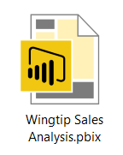
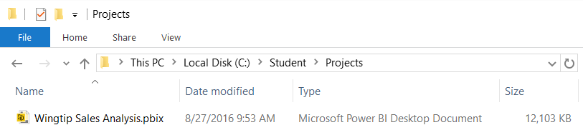
Projects and PBIX Files
Power BI Desktop projects saved using PBIX files
PBIX file contains data source definitions
PBIX file contains query definitions
PBIX file contains data imported from queries
PBIX file contains exactly one data model definition
PBIX file contains exactly one report
PBIX file never contains data source credentials
Notes:
Power BI Desktop projects are saved, loaded and published using PBIX files. A PBIX file is a ZIP archive created using the Open Packaging Convention format just like common Office documents such as DOCX files and XLSX files. The files for datasets that are stored inside and loaded from a PBIX file are managed internally by Power BI Desktop using Microsoft’s xVelocity Tabular database engine.
Each project created using Power BI Desktop is stored as a single PBIX file. Just about everything you create and configure when using Power BI Desktop is stored inside the PBIX file for one specific project. A PBIX file stores data source definitions and query definitions as well as tables of data which are populated and refreshed when queries are executed. A PBIX files also includes all the work you have done with data modeling and report design.
From a project management perspective, it’s important to understand that a PBIX file represents a single project which contains exactly one dataset and exactly one report. You cannot add a second report to a Power BI Desktop project. However, you can add as many pages as you would like to a project’s one and only report.
You should take note that Power BI Desktop will never store data source credentials in a PBIX file. For example, PBIX files never contain the user name and password required to access a secured resource such as a Online service or an on-premises SQL server database. Instead, Power BI Desktop provides the convenience of storing data source credentials in a local cache so you are not required to continually log into the same data source when working with Power BI Desktop. But these credentials are never published along with a PBIX file. After you publish a Power BI Desktop project by uploading its PBIX file, you will be required to configure data source credentials separately using the browser or by using some other automated technique.

Slide 14
Power BI Desktop and PBIX Project Files
PBIX is project file type for Power BI Desktop
PBIX stores queries, data model and report
PBIX file used by PowerBI.com and Power BI Embedded
PBIX file soon to become preferred report file format for SSRS

Slide 15
PBIX Data Source Types
Data Source Types
Imported
Direct Query

Slide 16
Demo: NorthwindRetro.pbix
Queries and Data Sources
Data Model
Report

Slide 17
Agenda
Power BI Embedded Overview
Working with PBIX Project Files
Provisioning Workspaces in Azure
Embedding Reports in a MVC Application
Configuring Datasets for DirectQuery Mode
Putting It All Together

Slide 18
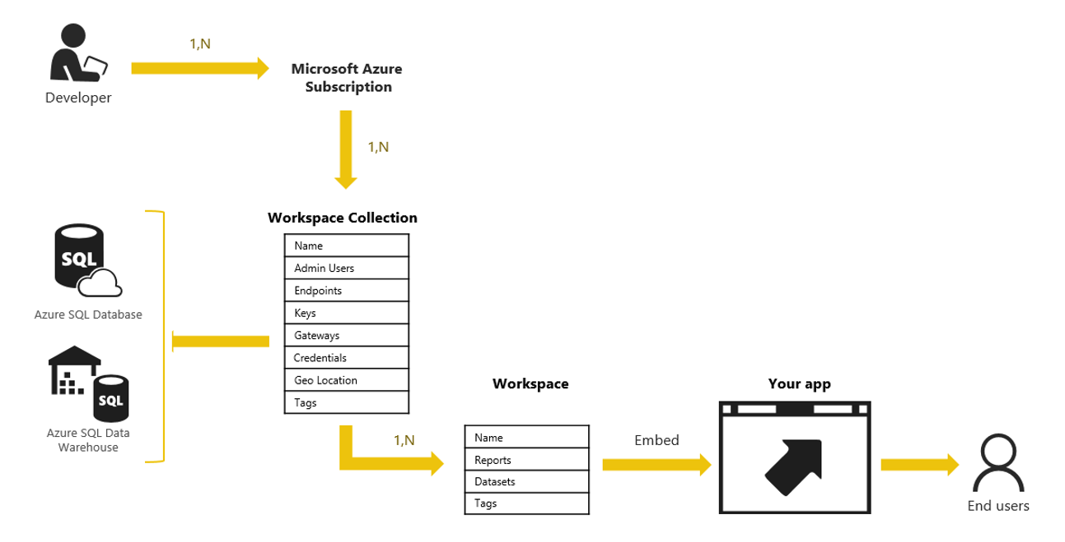
Power BI Embedded Service in Azure
Create Power BI workspace collection
Can be done by hand in Azure portal
Can be done with PowerShell and Power BI CLI utility
Can be done using C# and Azure ARM APIs

Slide 19
Workspace Collection
Top-level container for workspaces
Managing Workspace Collection
Access Keys
Keys used when securely calling the Power BI APIs
Users
Azure Active Directory (AAD) users that have administrator rights to manage the Power BI Workspace Collection through the Azure portal or ARM API.
Region
As part of provisioning a Workspace Collection Workspace Collection, you can select a region to be provisioned in. For more information, see Azure Regions.

Slide 20
Create-Workspace-Collection.ps1

Slide 21
Power BI CLI
Command-line tool
Supported on Windows, Mac and Linux

Slide 22
Import-PBIX-Into-Workspace.ps1

Slide 23
Agenda
Power BI Embedded Overview
Working with PBIX Project Files
Provisioning Workspaces in Azure
Embedding Reports in a MVC Application
Configuring Datasets for DirectQuery Mode
Putting It All Together

Slide 24
Embedding Internals
It’s an iFrame
It requires an embed token

Slide 25
Creating an ASP.NET MVC Application
Nuget Packages
X
Y
z

Slide 26
MVC Helper Classes
@HTML
Here’s the code on in the MVC view
Here’s the output on the web page

Slide 27
Power BI JavaScript API
Used to embed
JavaScript code creates an iFrame
Add code to show embed
Show code to display/hide nav and filter panel

Slide 28
Power BI JavaScript API Object Model
Report events
Show code for navigation

Slide 29
Agenda
Power BI Embedded Overview
Working with PBIX Project Files
Provisioning Workspaces in Azure
Embedding Reports in a MVC Application
Configuring Datasets for DirectQuery Mode
Putting It All Together

Slide 30
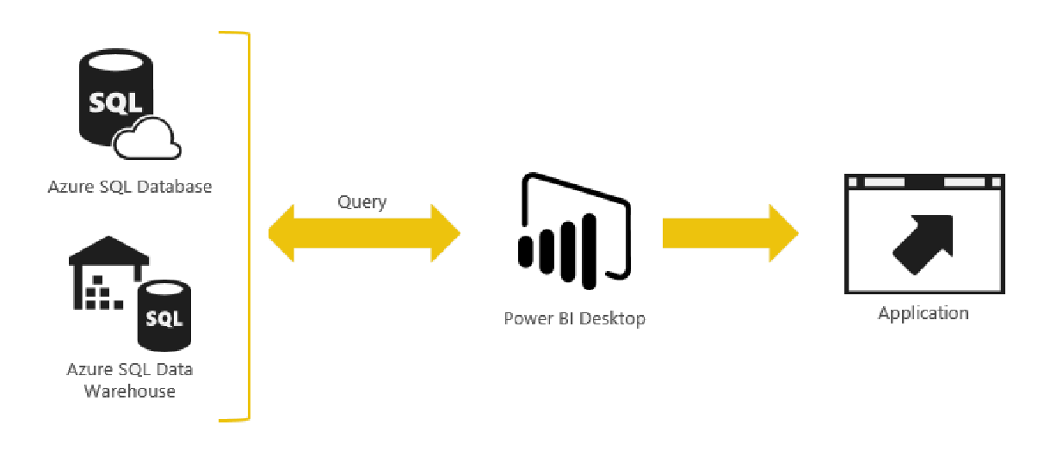
DirectQuery Mode
zzz

Slide 31
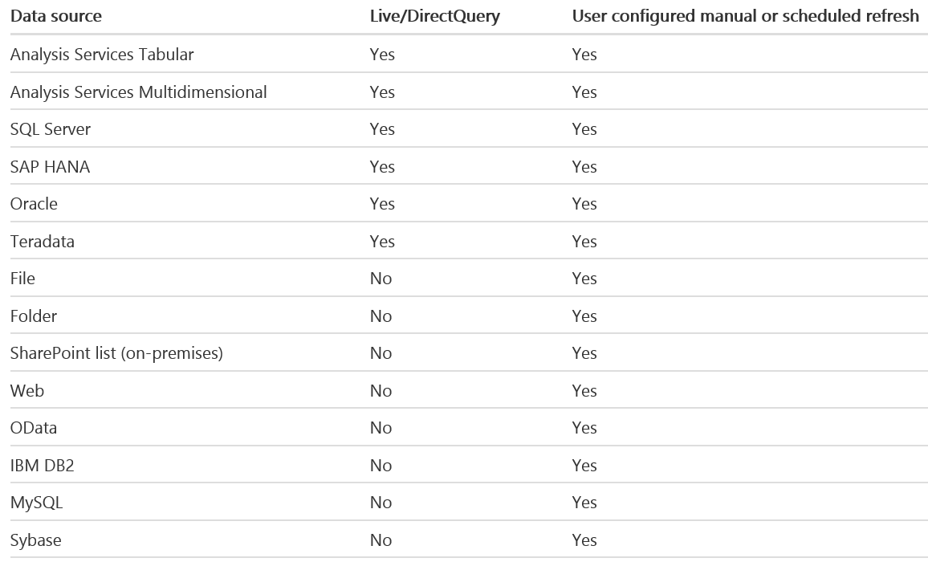
Supported Data Sources

Slide 32
Limitations of DirectQuery
DirectQuery imposes the following limitations
All tables must come from a single database
Many types of query steps are not supported
Relationship filtering limited to single direction
Time intelligence capabilities are not available
No special treatment of date columns
Calculated columns not allowed
By default, limitations placed on DAX in measures

Slide 33
Demo: WingtipSalesDirectQuery.pbix
Power BI Embedded does not support dataset refresh
Now way to refresh imported dataset – different than PowerBI.com
Requires delete and reimporting updated PBIX project
DirectQuery mode can be used to eliminate the refresh problem

Slide 34
Provisioning with C# and Azure REST APIs
Show code to upload
What is Nuget package for PowerBIClient?
Dataset management is important
Credentials cannot be included in PBIX
Credentials must be configured after PBIX import
Terminology confusion
Remember that Import = Dataset = Report

Slide 35
Configuring a Dataset for DirectConnect
Import
Modify data source connection string
Patch Azure Database credentials

Slide 36
Agenda
Power BI Embedded Overview
Working with PBIX Project Files
Provisioning Workspaces in Azure
Embedding Reports in a MVC Application
Configuring Datasets for DirectQuery Mode
Putting It All Together

Slide 37
Packages and APIs used in this webinar

Slide 38
Critical Path Training

Slide 39
Summary
Power BI Embedded Overview
Working with PBIX Project Files
Provisioning Workspaces in Azure
Embedding Reports in a MVC Application
Configuring Datasets for DirectQuery Mode
Putting It All Together

